Slide 1

Teaching Assignment
By
Ram Charan

Slide 2
Bubble Sort
Bubble sort is a simple sorting algorithm.
This sorting algorithm is comparison-based algorithm in which each pair of adjacent elements is compared .
The elements are swapped if they are not in order.

Slide 3
How it works :
Let's take
Int [ ] a = new a[ ] { 26, 4 , 35, 14, 78 }
Iteration 1 :
26 4 35 14 78
4 26 35 14 78
4 26 35 14 78
4 26 14 35 78

Slide 4
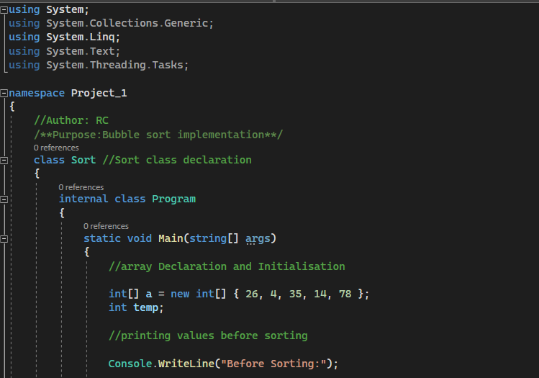
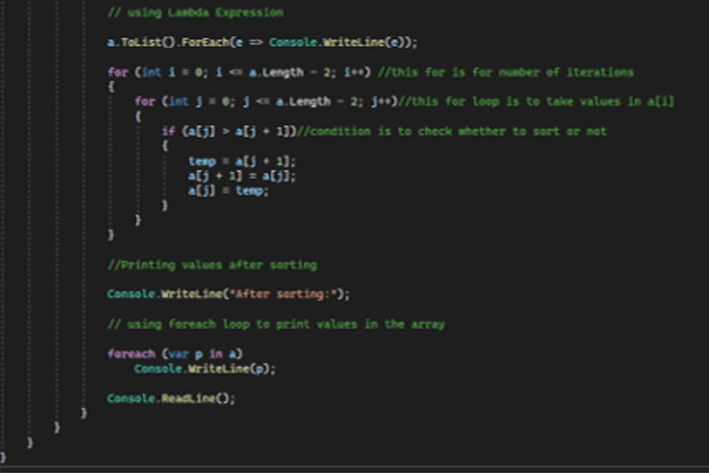

Slide 5
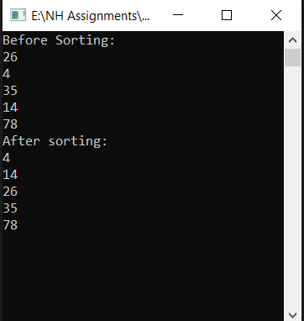
OUTPUT :
Before Sorting Numbers are not in order.
After Sorting Numbers are in order after two iterations.

Slide 6
Linear Search
It is also known as sequential search .
The Linear search is a technique which allows user to search a particular value from a list of values.
The Searching starts from beginning of the array.
The linear search compares target value with each value in the array one-by-one and stops when target element is found.

Slide 7
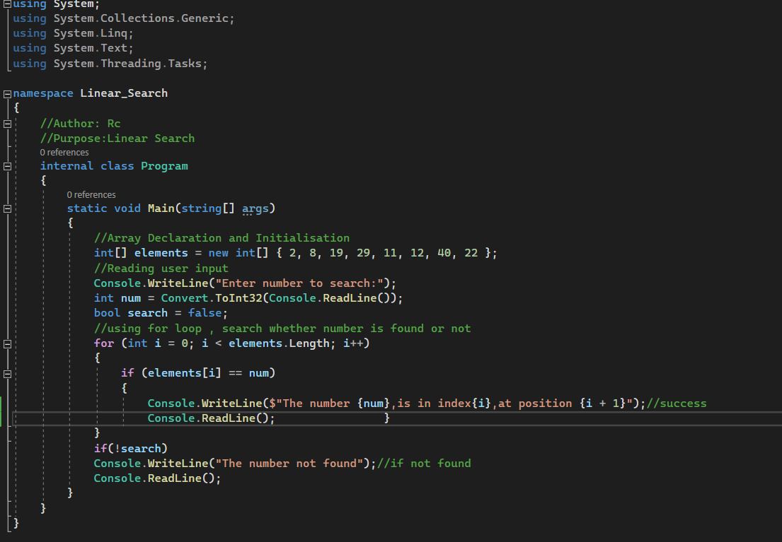
Code :

Slide 8
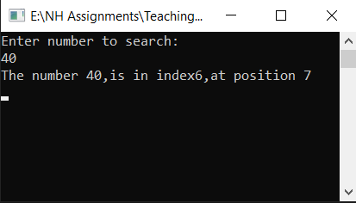
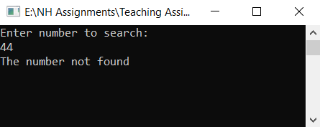
OUTPUT :

Slide 9
Binary Search
Binary search works on a sorted array.
The value is compared with the middle of the element of the array.
If equality found, then the part is eliminated in which the value is not there.
In the same way the other part is also searched.

Slide 10
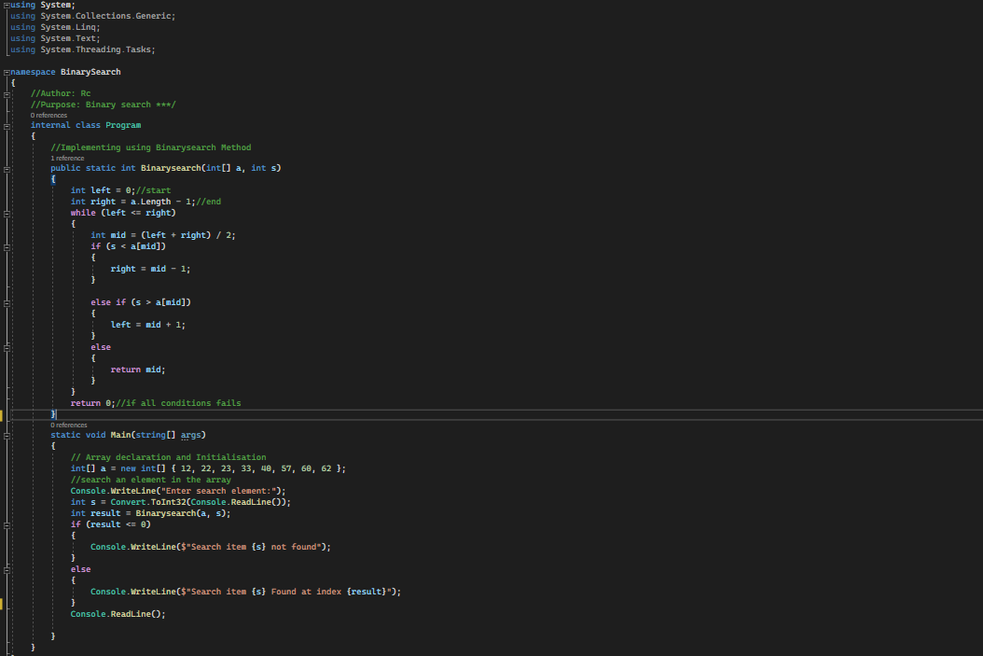
Code :

Slide 11
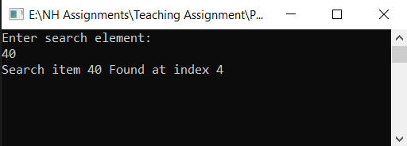
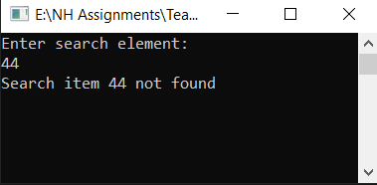
Output:

Slide 12

THANK YOU

